Slide 1


URBAN POLLUTION HEATMAP

Slide 2

Learning Objectives
Build a full-stack web app using Flask (backend) and Leaflet.js (frontend).
Integrate a trained ML model to make real-time pollution predictions based on location and time.
Use Leaflet.js to create interactive, map-based visualizations.
Create RESTful APIs in Flask to handle frontend-backend communication.
Visualize geospatial data dynamically using user input and real-time model inference.
GOAL
Source :
www.freepik.com/

Slide 3
Tools and Technology used
Python – Core programming language for backend and ML.
Flask – Lightweight web framework to serve the application and API.
Scikit-learn – For training and using the machine learning model.
Leaflet.js – JavaScript library for interactive maps.
HTML + CSS + JavaScript – Frontend technologies for UI and map interaction.
Joblib – For saving and loading the trained ML model.
OpenStreetMap – Free map tiles used with Leaflet.

Slide 4
Methodology
Data Collection & Preparation Simulated or real-world geospatial data (latitude, longitude, time) was used to represent pollution levels across urban areas.
Model Training A regression model (e.g., Random Forest) was trained using features like:
Latitude
Longitude The model predicts pollution levels as continuous numeric values.
Backend Development (Flask)
Created API endpoints:
/: Renders the map UI.
Integrated the ML model to handle predictions based on user input.
Frontend Development (Leaflet.js)
Displayed a real-time interactive map.
Fetched predictions from the backend and visualized results using color-coded markers/circles to represent pollution intensity.

Slide 5
Problem Statement:
Urban pollution significantly affects public health and quality of life.
Real-time pollution data is often limited, inaccessible, or non-visual.
Citizens and urban planners lack tools to predict pollution dynamically by time and location.
There's a need for a solution that predicts and visualizes pollution levels interactively.
This project addresses the gap by combining machine learning and interactive maps to display estimated pollution levels across a city.

Slide 6
Solution:
Developed a machine learning model to predict pollution levels based on:
Geographic coordinates (latitude, longitude)
Time features (hour of day, day of week)
Built a Flask-based backend API to handle real-time prediction requests.
Click any point on the map
Instantly view predicted pollution level at that location and time
Used color-coded map markers/circles to visually represent pollution severity.
Enabled a low-cost, scalable solution for urban pollution awareness and planning.
https://github.com/ARIGELA-NISHITHA/urban-pollution-heatmap-with-ml.git

Slide 7
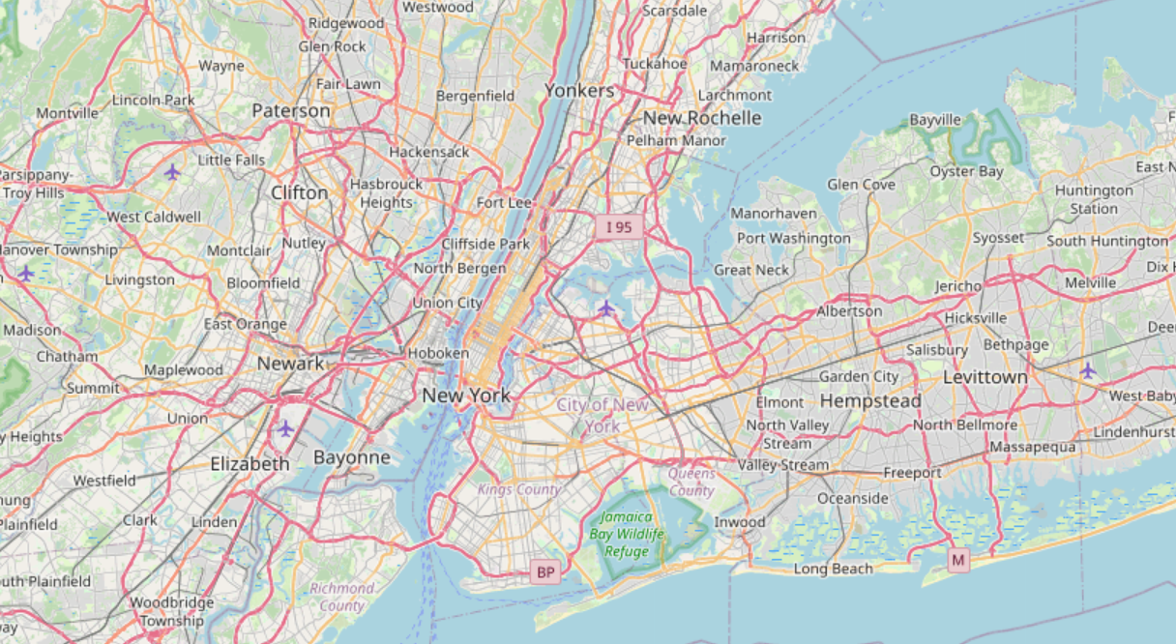
Screenshot of Output:

Slide 8
Conclusion:
This project successfully demonstrates how to integrate machine learning with web mapping to predict and visualize urban pollution.
The interactive heatmap provides an easy-to-use tool for users to explore pollution levels based on location and time.
Such tools can support public awareness, urban planning, and environmental monitoring efforts.
Future improvements could include integrating real pollution sensor data, adding weather conditions, and deploying the app for wider public use.
Overall, this project highlights the power of combining data science and web technologies to address real-world challenges.

